Slide 1
New York data Analysis to find the place to start the Business
Capstone Project.

Slide 2
Contents
Business understanding
Data collection
Data understanding and preparation
Exploratory data analysis
Modelling
Model Evaluation
Conclusion

Slide 3
Business Problem.
Analyze the New York Data and find the good choice to start the Business in any of the "Borough" in New York.

Slide 4
Data Source and Wrangling.
The source of the New York data is from IBM Watson in the form of JSON file and it has been cleaned and wrangled to the required format.
The Neighborhood of New York data is loaded from Foursquare API and it has been wrangled.
The Geographical coordinates of New York and its Borough’s have been retrieved from Geocoder

Slide 5
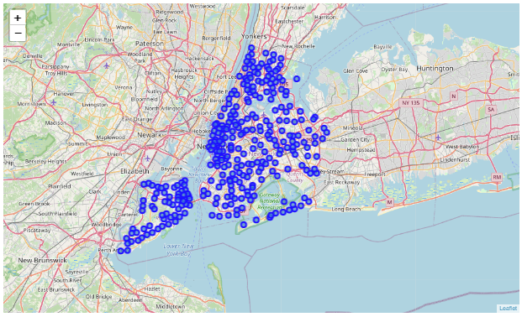
Get the New York Coordinates and visualize on map.

Slide 6
Segment the New York data into individual Borough
Below are the list of Borough in New York
Bronx
Manhattan
Brooklyn
Queens
Staten Island

Slide 7
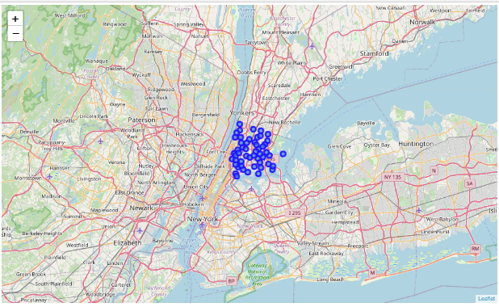
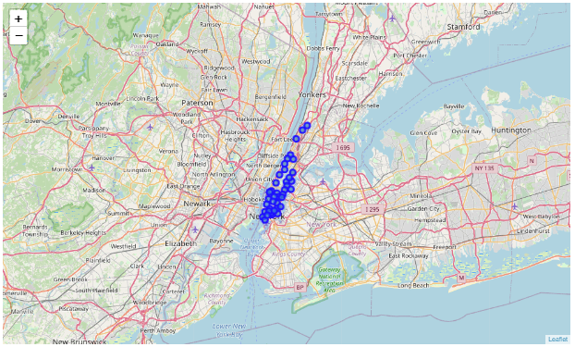
Visualize the Borough on Map
Bronx
Manhattan

Slide 8
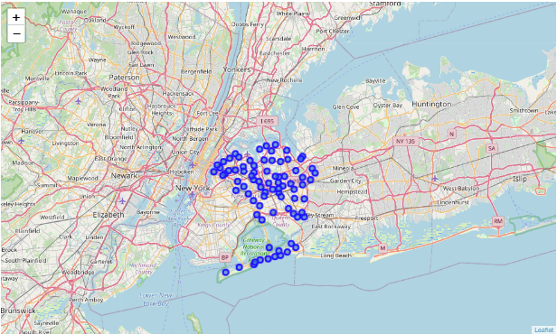
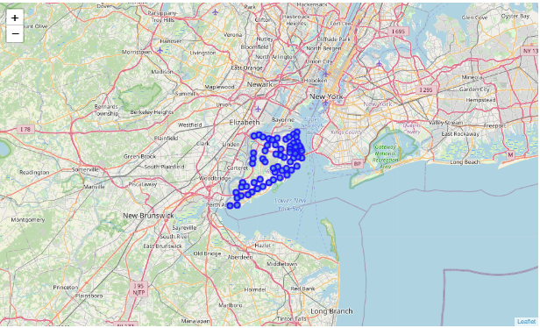
Visualize the Borough on Map
Queens
Staten Island

Slide 9
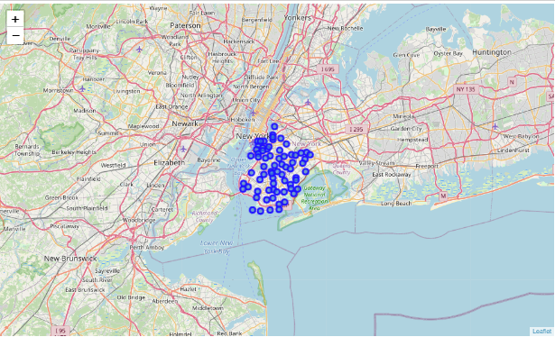
Visualize the Borough on Map
Brooklyn

Slide 10
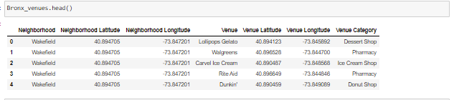
Wrangle the Neighborhood data from Foursquare API
Get the Neighborhood data of each Borough and save it as a Data Frame.
Data looks like below for all the Borough in New York.

Slide 11
Feature selection and One hot encoding
From the Neighborhood data which collected from Foursquare API, Select the features Venue and Venue category.
Apply the One hot encoding to the selected features and merge with Neighborhood feature.
Group the data with Neighborhood and take the mean and stored as a Data Frame.

Slide 12
Identifying the Algorithm and Parameter Tuning.
K-Means Cluster algorithm has been identified to group the data based on venue and Venue Category.
Tune the parameter “K” and identify using Elbow method.

Slide 13
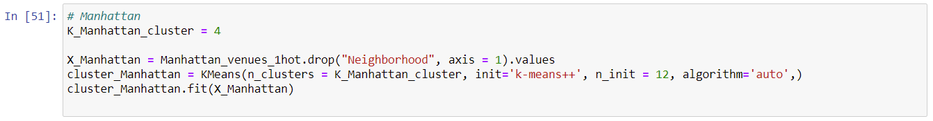
Model building with optimal K value
Build K Means model with optimal K – value which is identified using Elbow method.
Fit the data to the model

Slide 14
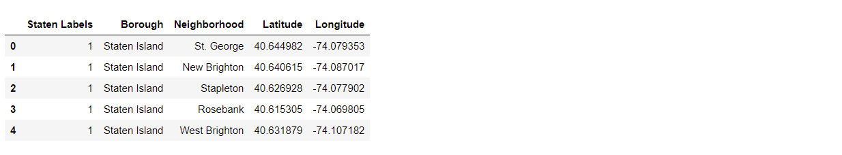
Identify the cluster labels for each Borough
Identify the cluster labels for each Borough and merge with Neighborhood data.
The below data is for Staten Island.

Slide 15
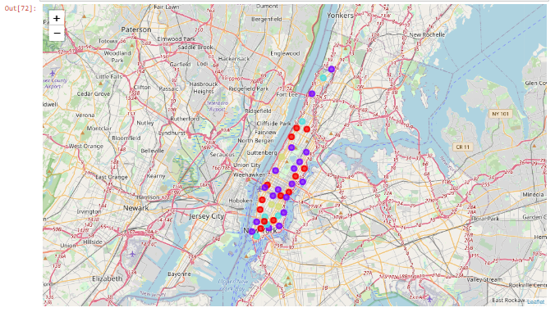
Evaluation
Visualize the resulting clusters of each Borough on map

Slide 16
Conclusion
With reference to the cluster data, Brooklyn is the best place to start the business as the competitors are less in a radius of 500.

